Slide 1
Writing In Reception

Slide 2
Writing In The Classroom
Children have access to writing opportunities around the classroom.
There is a specific writing area which contains notepads, envelopes, plain paper, phoneme mats, clip boards and whiteboards – these can be accessed inside and outside and children are encouraged to use them around the classroom.

Slide 3
Writing During Whole Class Lessons
Writing is taught within the phonics lessons and in discrete literacy lessons.
Children are encouraged to write cvc words every day in the phonics lessons. These are using sounds they already know and are written after whole class collaboration eg make the word, say the sounds and read the word, write the word
There is also a dictation session several times a week which the children having to write a sentence using words and sounds that have been in the phonics lessons the week before – for consolidation.

Slide 4
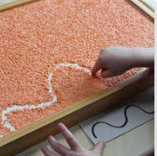
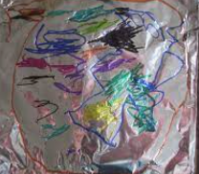
Writing can look like squiggles and marks. Children are encouraged to give meaning to this by explaining or ‘reading’ themselves what they have written

Slide 5
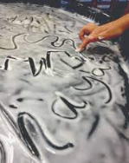
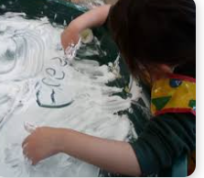
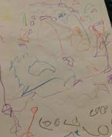
Next you are likely to see some recognisable letters being formed such as the ones in their own name. These may still be accompanied by squiggles and other marks.

Slide 6
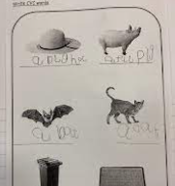
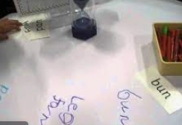
Next more letters are used correctly to represent sounds which may then look like short cvc words.

Slide 7
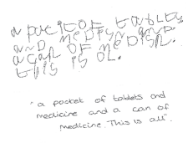
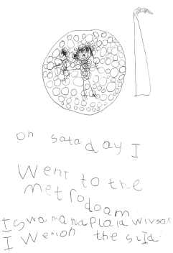
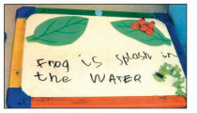
‘Expected’ Writing For The End Of The EYFS

Slide 8
Remember…….
“say the sounds and write the word”
Sounds mats are available for children to use to apply their phonic knowledge and remind them of what sounds look like in the written form

Slide 9
Writing At Home
Encourage the children to have a go and write in a range of contexts.
Birthday cards
Shopping lists
Letters
Labels around the home

